Slide 1
Chapter 6
Shearing Stresses in Beams and Thin-Walled Members

Slide 2
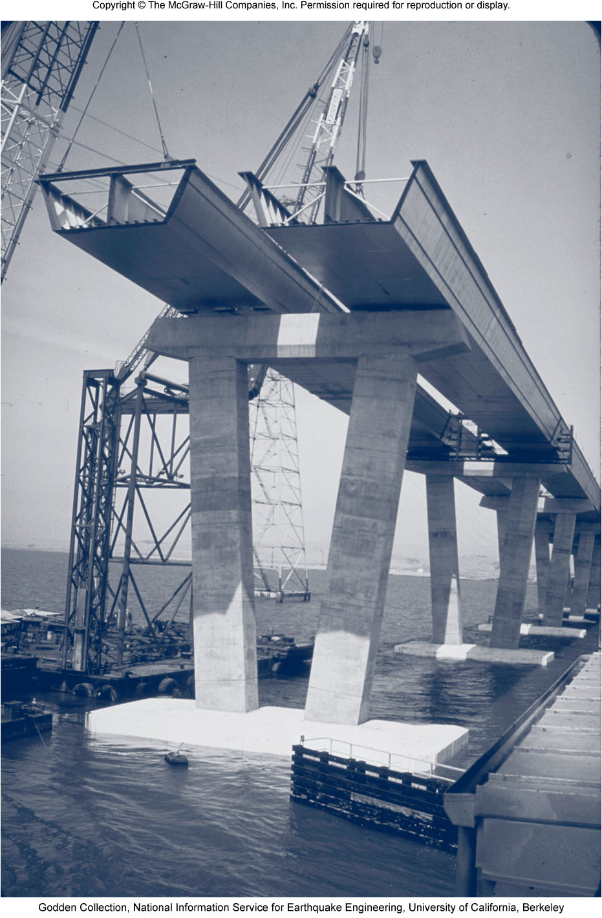
Introduction
Previously, for transverse loading, we limited our analysis to the normal stresses caused by bending moments since the dominant criterion in the design of a beam for strength is the maximum value of the normal stress.
Transverse loading will lead to shearing stresses too. For the design of beams with particular cross sections, shearing stresses can be important, and thus their analysis will be considered.
In the picture, a reinforced deck will be attached to each of the steel sections shown to form a composite box girder bridge.
In this part of the course, the shearing stresses will be determined in various types of beams and girders.

Slide 3
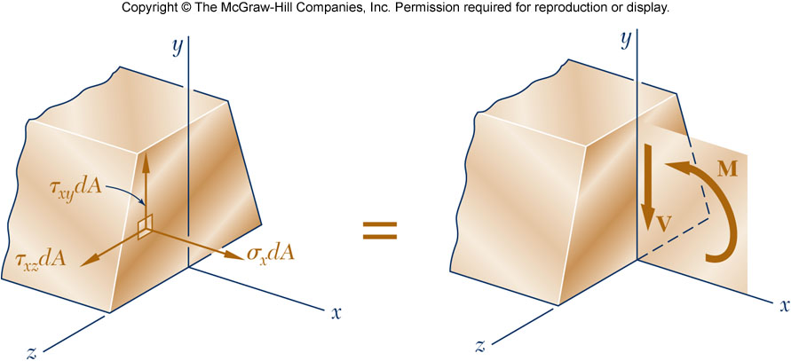
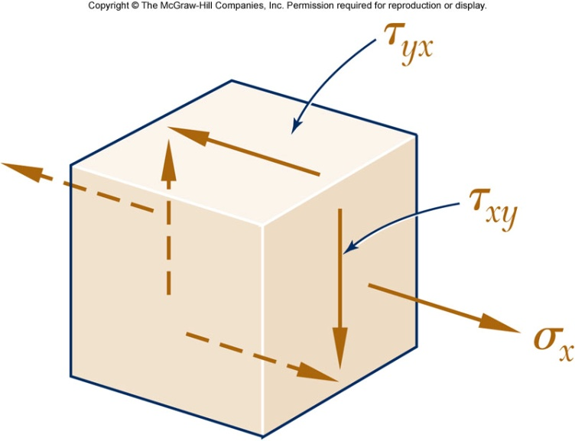
Introduction
Transverse loading applied to a beam results in normal and shearing stresses in transverse sections.
Distribution of normal and shearing stresses satisfies
Consider the case
When shearing stresses are exerted on the vertical faces of an element, equal stresses must be exerted on the horizontal faces

Slide 4

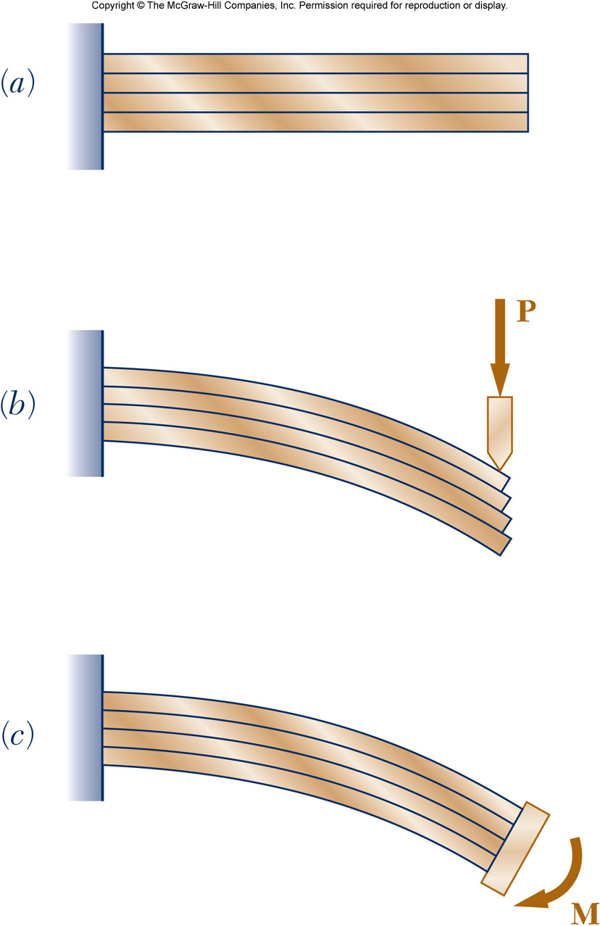
Introduction
If τ_{xy} is present then τ_{yx} must be present too. This means that longitudinal shearing stresses must exist in any member subjected to transverse loading.
Consider a cantilever beam made of separate planks clamped together at one end. When subjected to a transverse load P, the planks are observed to slide with respect to each other. While sliding does not exist, the tendency to slide does exist, showing that stresses occur on longitudinal and transverse planes.
When a moment M is applied the planks will bend into concentric arcs of circle and will not slide, thus verifying the fact that shear does not occur in a beam subjected to pure bending.

Slide 5
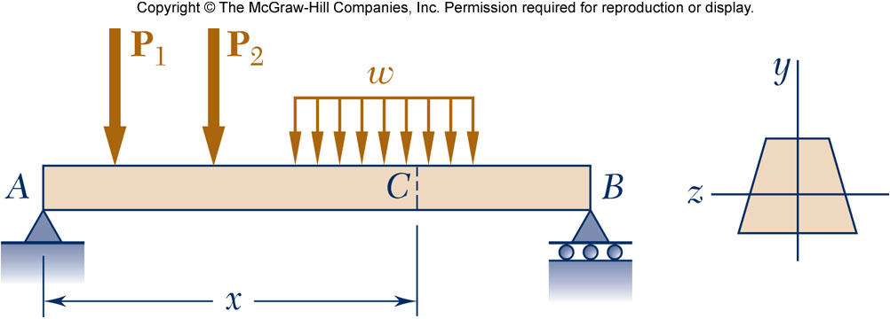
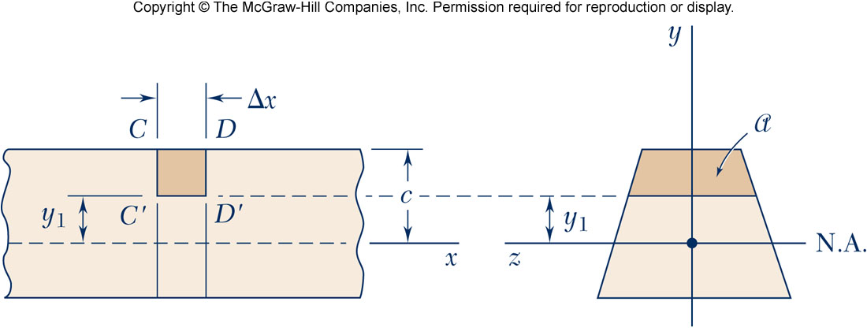
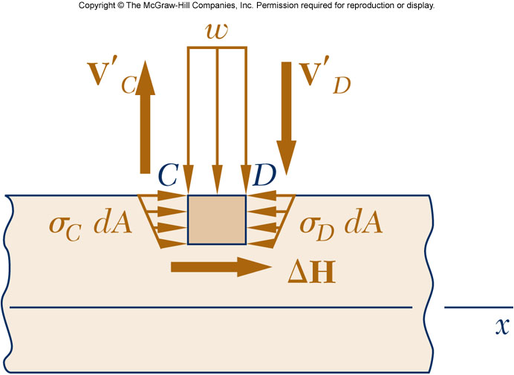
Shear on the Horizontal Face of a Beam
Consider the prismatic beam shown and at a distance x from A, detach from the beam an element, CDD’C’ of length Δx.
For equilibrium of beam element

Slide 6
Shear on the Horizontal Face of a Beam
Let Q be the first moment with respect to the neutral axis of the cross section a located above the line y = y₁
Let q be the shear flow, the horizontal shear per unit length

Slide 7
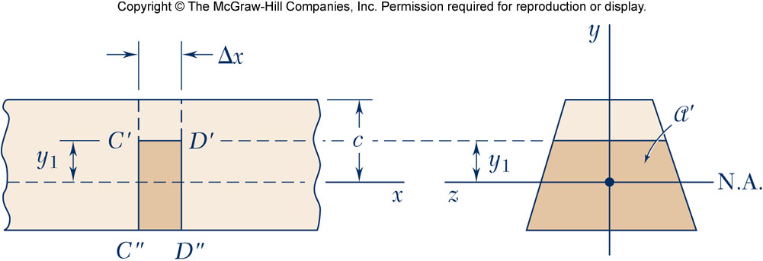
Shear on the Horizontal Face of a Beam
Shear flow on the Upper area
Q: First moment above y₁
I: Second moment of A
Shear flow on the Lower area
Q’: First moment of a’ below y₁
Q+Q’ : First moment of A with respect of the neutral axis

Slide 8
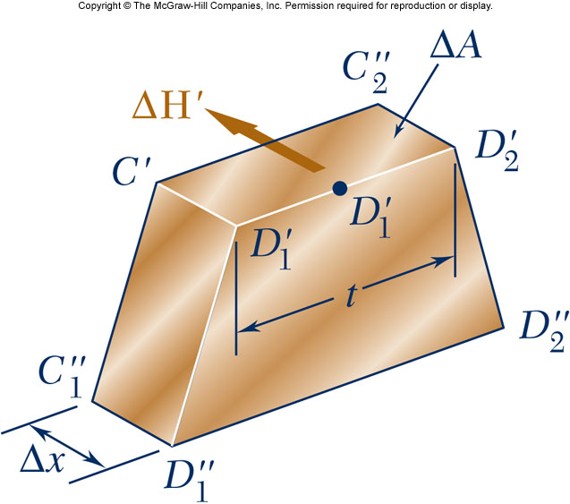
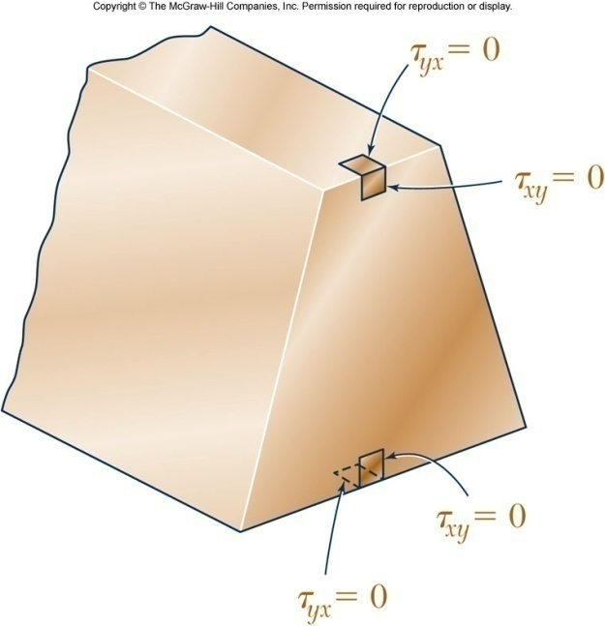
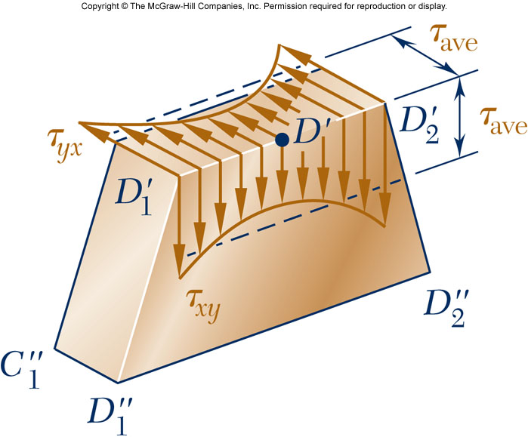
Shearing Stress in a Beam
The average shearing stress on the horizontal face of the element is obtained by dividing the shearing force on the element by the area of the face.
On the upper and lower surfaces of the beam, τ_{yx}= 0. It follows that τ_{xy}= 0 on the upper and lower edges of the transverse sections.
If the width of the beam remains small compared to its depth, the shearing stress varies slightly along the line D₁’D₂’.

Slide 9
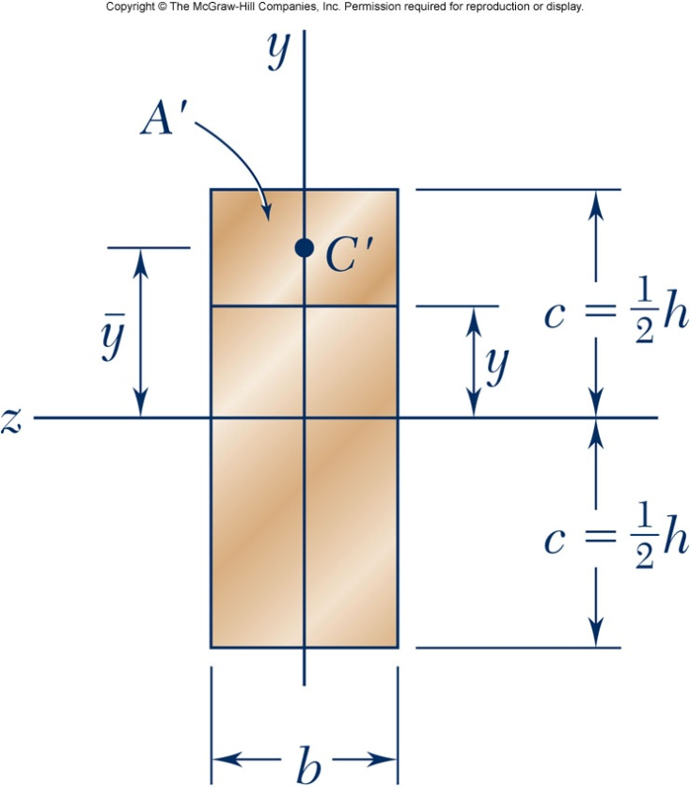
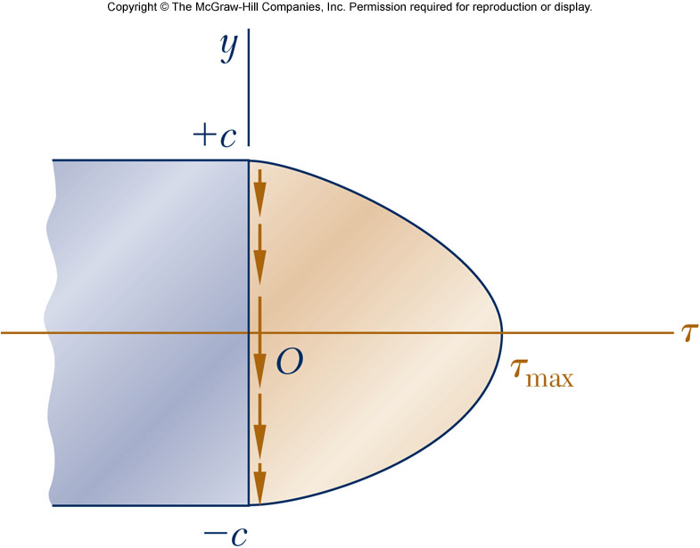
Shearing Stresses in Common Beams
Rectangular cross section

Slide 10
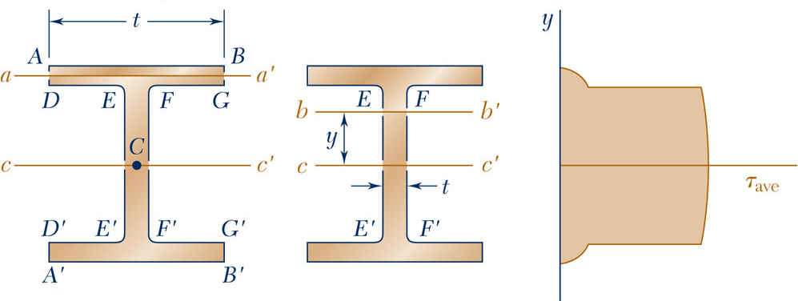
Shearing Stresses in Common Beams
American Standard (S-beam) and wide-flange (W-beam) beams
Assume that the entire shear
load is carried by the web

Slide 11
Example 1
6-1: Three full-size 50 × 100-mm boards are nailed together to form a beam that is subjected to a vertical shear of 1500 N. Knowing that the allowable shearing force in each nail is 400 N, determine the largest longitudinal spacing s that can be used between each pair of nails.

Slide 12
Example 1

Slide 13
Example 2
6-10: For the beam and loading shown, consider section n-n and determine (a) the largest shearing stress in that section, (b) the shearing stress at point a.

Slide 14
Example 2

Slide 15
Example 3
6-18: For the beam and loading shown, determine the minimum required width b, knowing that for the grade of timber used, σ_{all}= 12 MPa and τ_{all} = 825 kPa.

Slide 16
Example 3

Slide 17
Example 4
6-21: For the beam and loading shown, consider section n-n and determine the shearing stress at (a) point a, (b) point b.

Slide 18
Example 4

